Slide 1
FudgeMart and FudgeFlix
Sales Analysis
Anna Shah, Josh Wiser, Kelly Arseneau

Slide 2


Business Questions
What products contribute to the most overall profit? How does their performance vary?
How do different subscription plans compare (total number of customers, number of artists, songs, etc), and what is the impact of subscription pricing on overall ratings?
What is the profit split between Fudgeflix and Fudgemart?

Slide 3
Dimensions
Fact Table
DimProduct
Fudgemart
FudgeFlix
Products
Plans
🔑 factSalesKey
🔑 customerKey
🔑 productKey
✔ orderQty
✔ retailPrice
✔ wholesalePrice
🔑 orderDateKey
✔ orderId
DimDate
DimCustomer
Order Date
Account Billilling Date
Customers
Accounts
(customer demographics)

Slide 4
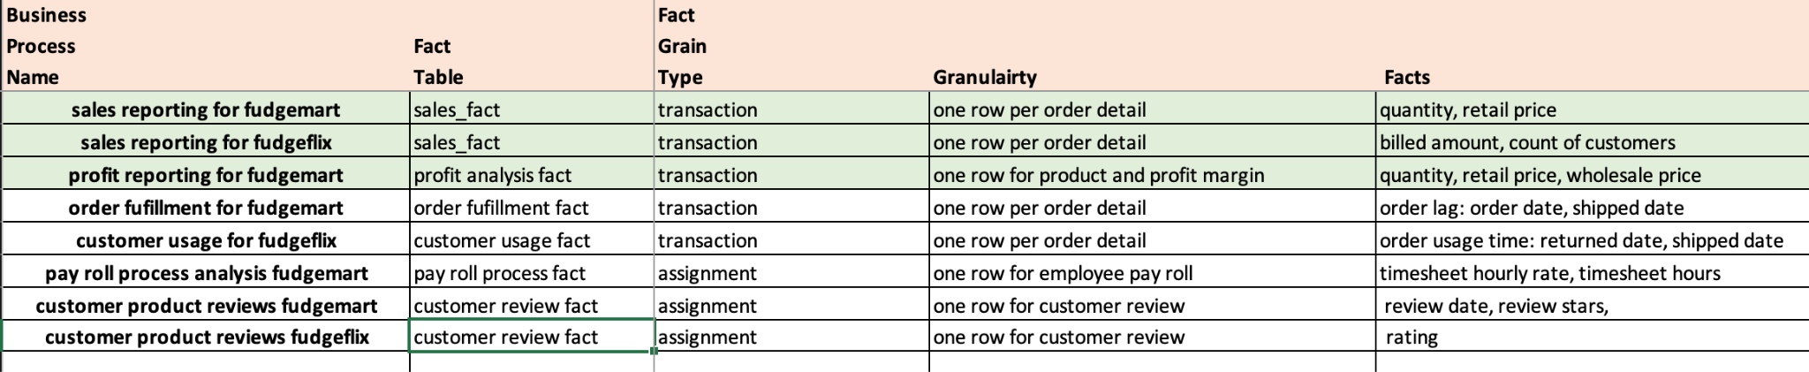
High Level Model

Slide 5
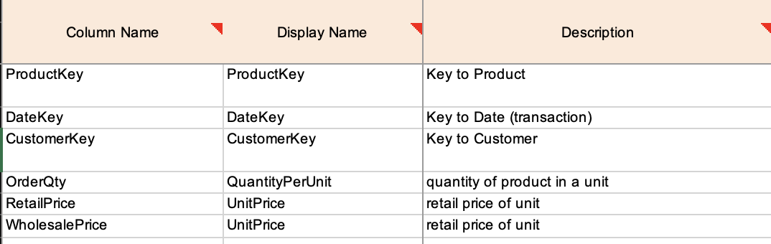
Detailed Dimensional Model FactSales

Slide 6
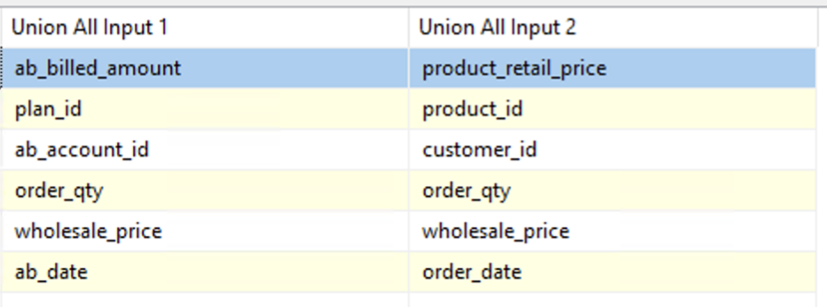
ETL Process (fudegmart - fudgeflix)
Customer ID - Account ID = DimCustomer
Product ID - Plan ID = DimProduct
Order Qty - 1 = DimProduct
Order date - Billed Date = DimDate -> FactSales (OrderDateKey)
Wholesale Price - $0 = FactSales
Retail Price - Amount Billed = FactSales
FudgeFlix
FudgeMart

Slide 7
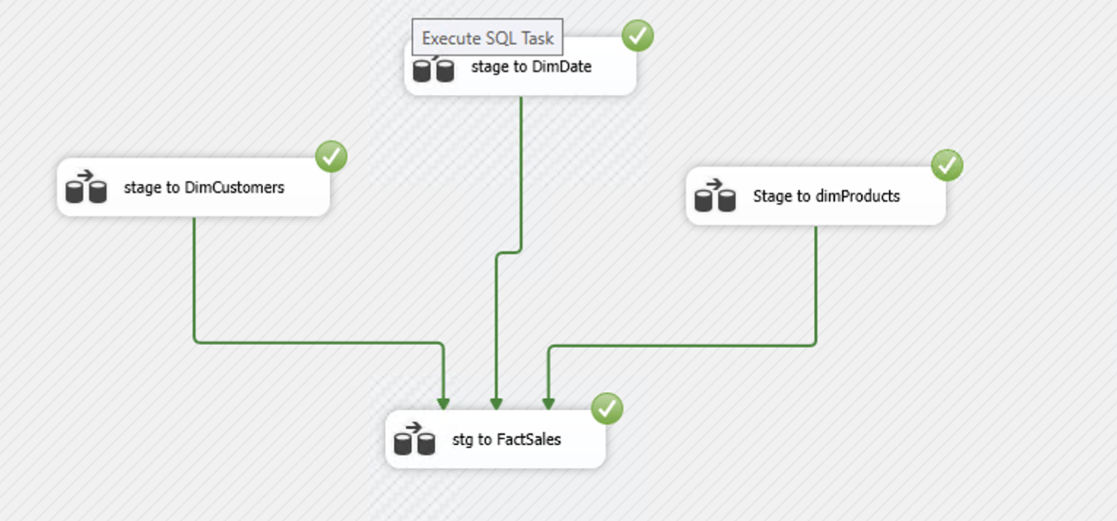
ETL Process (dim to fact)

Slide 8
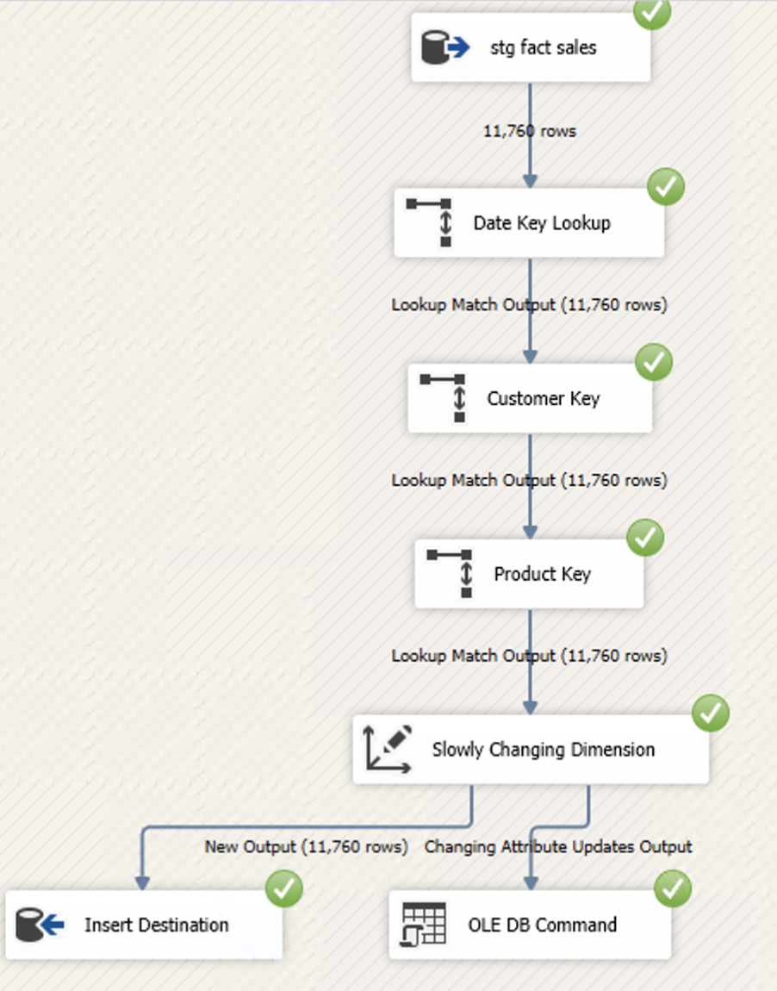
ETL Process (stage to dw)
11,760 rows

Slide 9
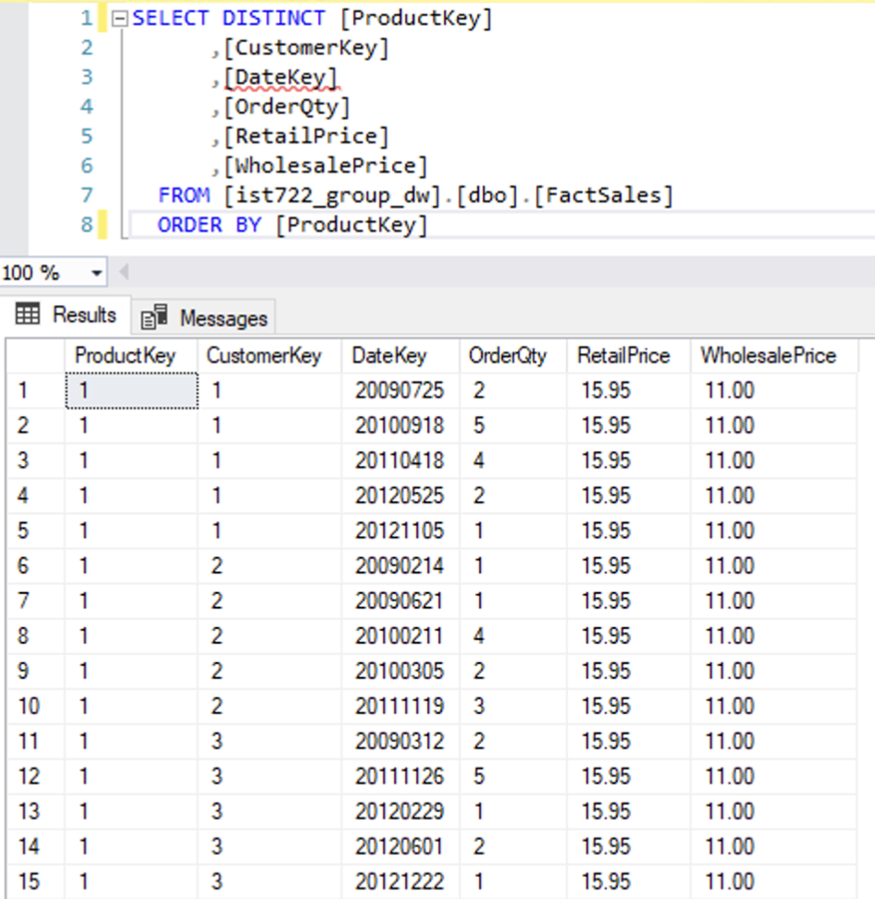
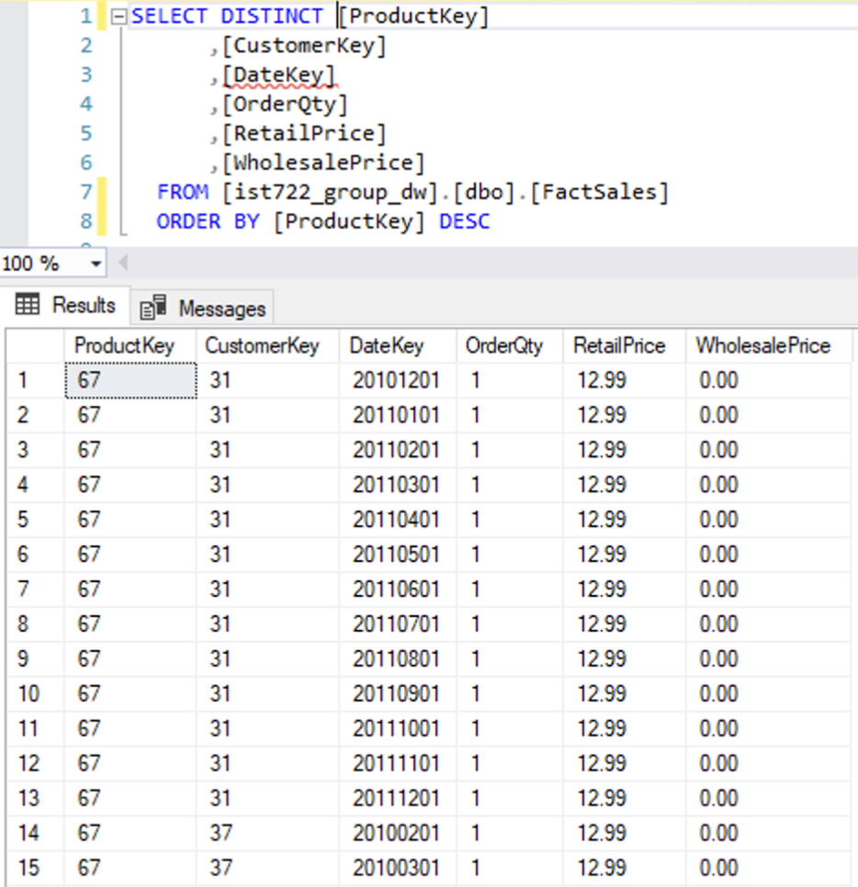
Fudgemart
Fudgeflix

Slide 10
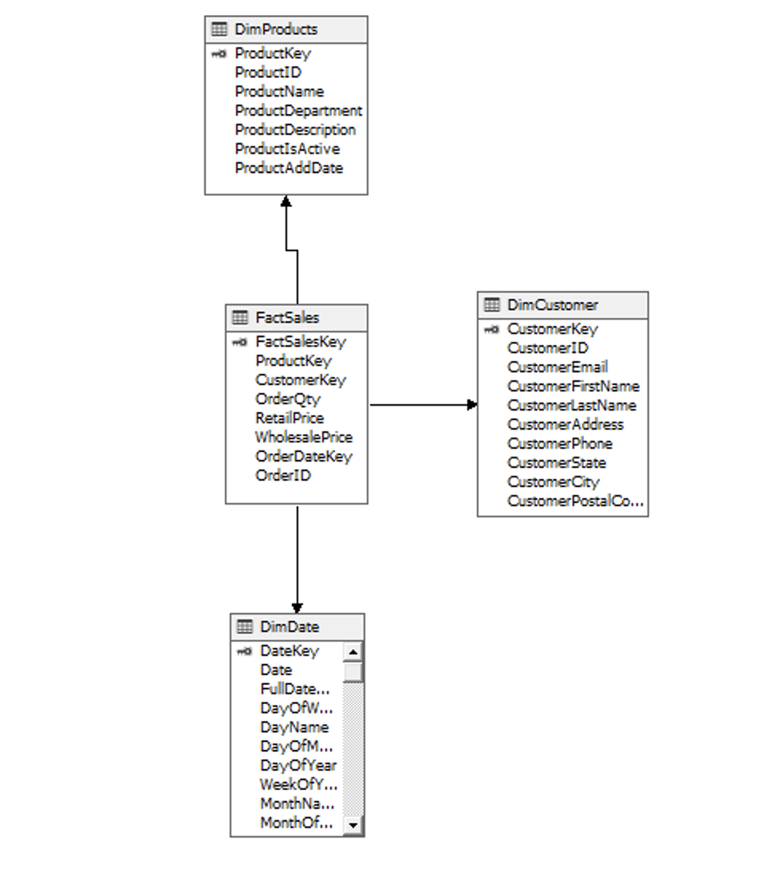
Star Schema
FactSales (Fact Table):
Contains measures: OrderQty, RetailPrice, WholesalePrice
Additional measures done in PowerBI
DimProducts (Dimension):
Describes products: ProductName, ProductDepartment, etc.
Linked to FactSales via ProductKey
DimCustomer (Dimension):
Describes customers: CustomerName, Email, Address, etc.
Linked to FactSales via CustomerKey
DimDate (Dimension):
Describes dates: Date, Year, Month, Day of Week, etc.
Linked to FactSales via DateKey

Slide 11
Business Questions
How do different subscription plans compare (total number of customers, number of artists, songs, etc), and what is the impact of subscription pricing on overall ratings?

Slide 12
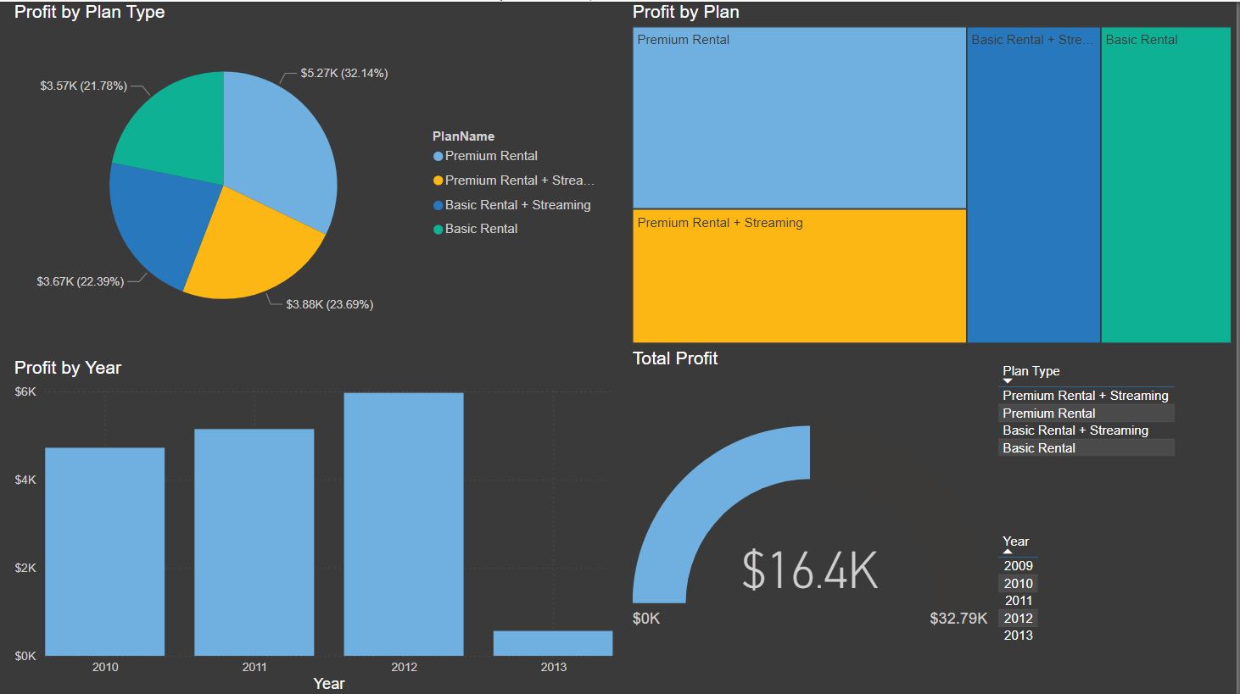
Power BI Part 1 - Fudgeflix Inc.
Pie Chart (Profit by Plan Type):
Shows distribution of profit by plan type
Largest segment: Premium Rental
Tree Map (Profit by Plan):
Visualizes profit contribution of different plans
Premium Rental
Bar Chart (Profit by Year):
Displays yearly profit trends
Peak profit in 2012
Gauge (Total Profit)
Total Profit of $16.4k w/ goal of $32.79k
Slicers:
Filter by Plan Type and Year

Slide 13
What products contribute to the most overall profit? How does their performance vary?

Slide 14
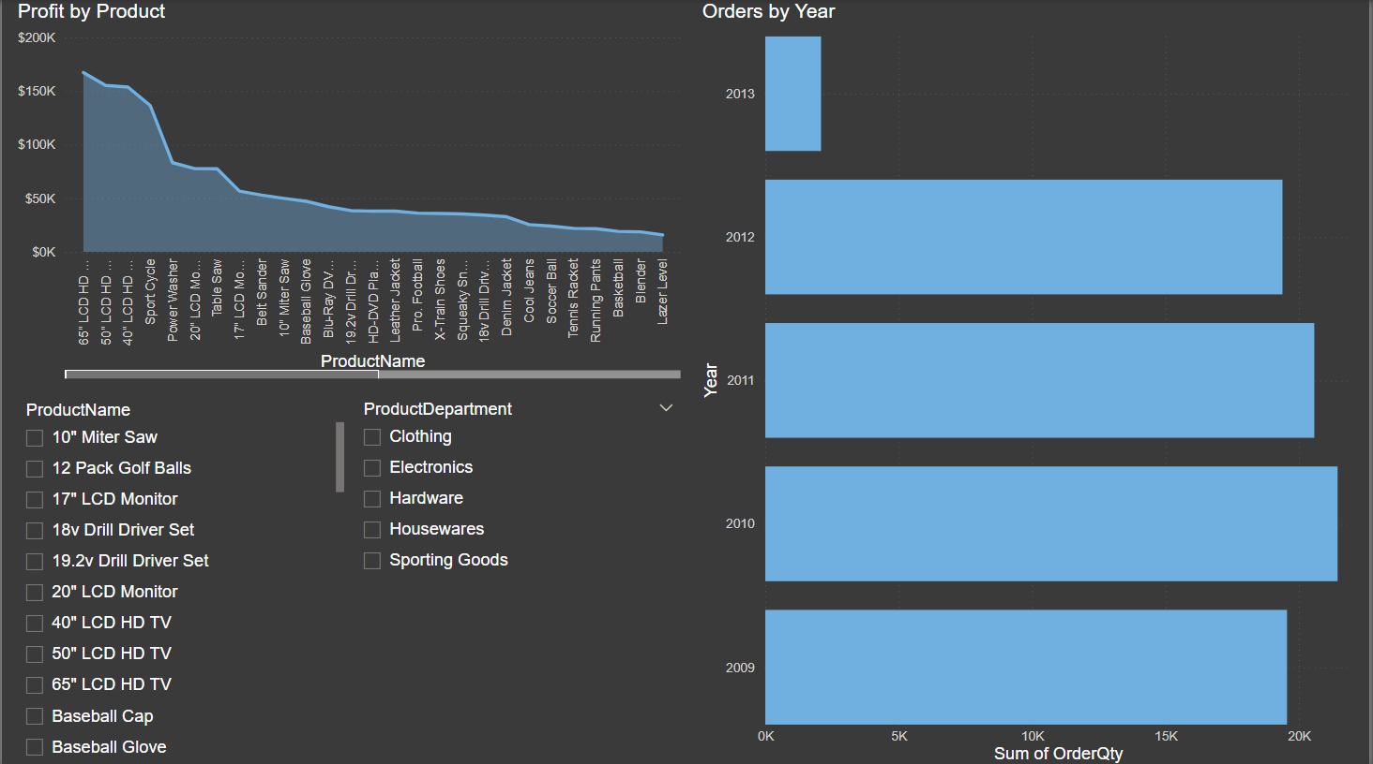
Power BI Part 2 - Fudgemart Inc.
Line Chart (Profit by Product):
Displays profit distribution across different products
Highest profit from 65" LCD HD TV
Bar Chart (Orders by Year):
Visualizes order quantities by year
Most orders occurred in 2010
Product List and Filters:
Shows product names with department filters
Allows filtering by product categories like Electronics, Clothing, Hardware, etc.

Slide 15
What is the profit split between Fudgeflix and Fudgemart?

Slide 16
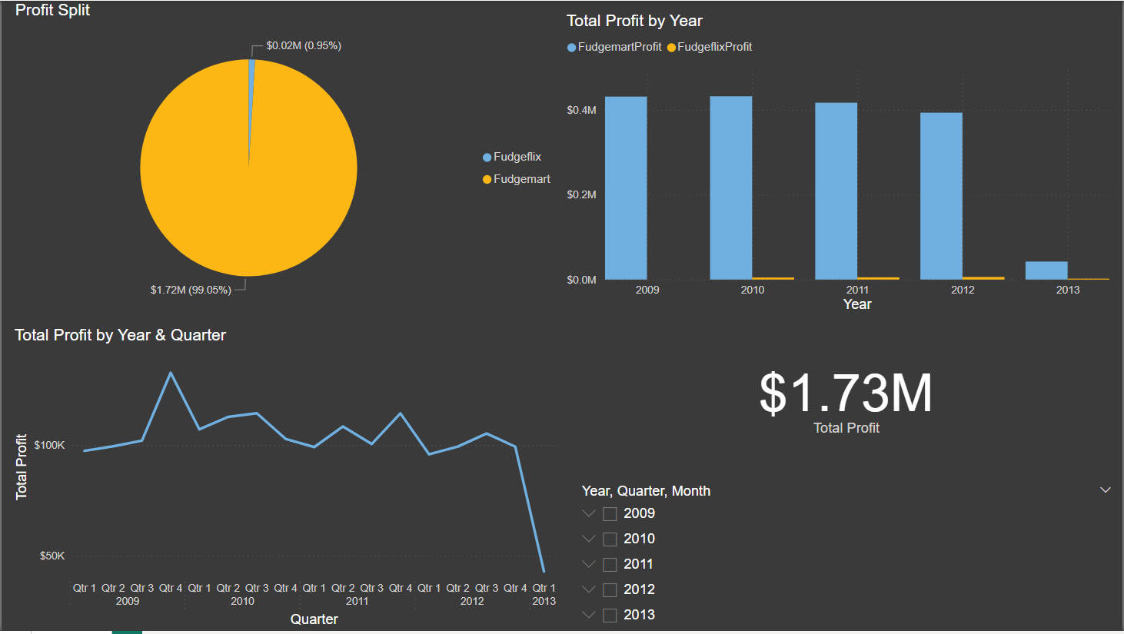
Power BI Part 3 - Fudgemart Inc & Fudgeflix Inc Conglomerate
Pie Chart (Profit Split):
Fudgemart profit share is 99.05%
Fudgeflix contributes 0.95% of total profit
Bar Chart (Total Profit by Year):
Breaks down profit by Fudgemart and Fudgeflix for each year
Fudgemart consistently generates higher profits
Line Chart (Total Profit by Year & Quarter):
Profit trends across quarters for all years
Profit fluctuates by quarter
Total Profit Indicator:
Total combined profit: $1.73M
Notes:
Did we have the data for all of 2013? Should colors stay the same between graphs, e.g. keep fudgemart yellow in both. Which department was the highest profiting? I’m surprised that with a wholesale amount of 0, fudgemart was more profitable.

Slide 17
Recommendations
Remove the FactSalesKey on the FactSales table make OrderId the business key for FactSales Table
OrderID (Fmart)
AccountBilledID (Fflix)
FactSales Table BusKey =
OrderID
(To replace FactSalesKey)
2. Structure the Total Profit by Year & Quarter line graph to be by month to allow us to include data from 2013 even though we don’t have the data for all of quarter 1.

Slide 18

Any Questions?

